Slide 1

Calculate Square And Cube by hierarchial inheritance
By : RISHIKA (54) , SUMAN SAURABH (61) , SWARNIM (64)

Slide 2
IOSTREAM HEADER FILE
#include<iostream> is a preprocessor statement. It is used in C++ in order to include the header file “iostream” in the program. Iostream is used to invoke the commonly used functions like cout , cin
in a C++ program. Iostream stands for input output stream.

Slide 3
What is CLASS ?
A class is a user defined data type which binds the data members and their associated method /functions together . Class is mere a blueprint or a template .
It is just like the structures in c / c++ . The only difference is that , in a class we can define member functions .A class is a group of object that share common characteristics, properties and relationships.

Slide 4
Characteristics of a CLASS ?
If class name is made of more than one word, then first letter of each word must be in uppercase. Example , class Study, class StudyTonight etc
Classes contain, data members and member functions, and the access of these data members and variable depends on the access specifiers .
Class's member functions can be defined inside the class definition or outside the class definition.
Class in C++ are similar to structures in C, the only difference being, class defaults to private access control, where as structure defaults to public.
All the features of OOPS, revolve around classes in C++. Inheritance, Encapsulation, Abstraction etc.
Objects of class holds separate copies of data members. We can create as many objects of a class as we need.
Classes do posses more characteristics, like we can create abstract classes, immutable classes, static class , etc.

Slide 5
What are member function ?
Member functions are the functions, which have their declaration inside the class definition and works on the data members of the class. The definition of member functions can be inside or outside the definition of class.
If the member function is defined outside the class, then we have to use the scope resolution :: operator along with class name along with function name.
Inside main() we will create object of class, and will call the member function using dot . operator.

Slide 6
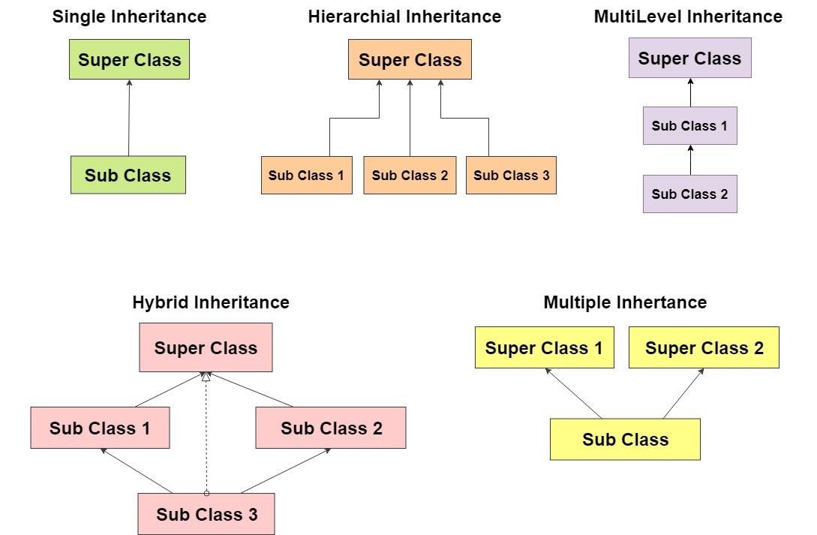
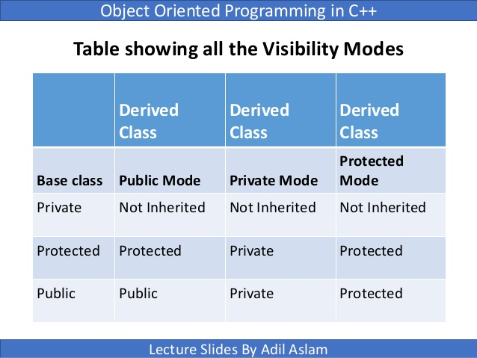
What is Inheritance ?
Inheritance is the capability of one class to acquire properties and characteristics from another class. The class whose properties are inherited by other class is called the Parent or Base or Super class. And, the class which inherits properties of other class is called Child or Derived or Sub class . Inheritance makes the code reusable.
All members of a class except Private, are inherited

Slide 7
In this project , we have created three classes :
BASE CLASS - Class name is Number and it has a two member function .
void getNumber(void) - It inputs the number from user through keyboard .
int returnNumber(void) - It returns the number that user entered .
FIRST DERIVED CLASS - Class name is Square . It inherits base class publically . It has one member function .
int getSquare(void) - It calculates the square of number and returns it .

Slide 8
SECOND DERIVED CLASS - Class name is Cube. It inherits base class publically . It has one member function .
int getCube(void) - It calculates the cube of number and returns it .
In int main() , we created objects of both the derived class(Square , Cube) .And with the help of dot operator we called member function . That was inherited from base class [ getNumber() ] and the one . Which was already declared in its public part .

Slide 9
Thank You

